Slide 1
Umamaheswaran
Senior Software Engineer, BizTalk360
@UMW360

Slide 2
Web app deployment process
Release
Deactivate
Update
Activate
Test

Slide 3





Azure App Service
Azure App Service Family
Web Apps
Web apps that scale with your business
Mobile Apps
Build mobile apps for any device
Logic Apps
Automate business processes across SaaS and on-premises
API Apps
Build and consume APIs in the cloud

Slide 4
Azure Web Apps
Support a variety of languages and platforms
.NET, Java, Node.js, PHP, Python, and more
Support scaling (manual or auto) and load balancing
Support slots for staged deployments and A/B testing
Support continuous integration
Familiar and Fast
Leverage existing skills, plus languages, frameworks, and tools you're familiar with
Enterprise Grade
ISO-, SOC2-, and PCO-compliant with enterprise-level SLAs
Global Scale
Scale up and down as needed, manually or automatically

Slide 5
Scaling - Cloud Computing Patterns
Inactivity
Period
Compute
Compute
t
t
On and Off
Unpredictable Bursts
On & off workloads (e.g. batch job)
Over provisioned capacity is wasted
Time to market can be cumbersome
Unexpected/unplanned peak in demand
Sudden spike impacts performance
Can’t over provision for extreme cases
Compute
Compute
t
t
Growing Fast
Predictable Bursts
Successful services needs to grow/scale
Keeping up w/ growth is big IT challenge
Cannot provision hardware fast enough
Services with micro seasonality trends
Peaks due to periodic increased demand
IT complexity and wasted capacity

Slide 6
Scaling Up vs. Scaling Out
Scale Up
Scale Out
Vary the VM size
Vary the VM count
1 Core w/ 1.75 GB RAM 2 Cores w/ 3.5 GB RAM 4 Cores w/ 7 GB RAM
Max 3* instances Max 10 instances Max 20/50** instances

Slide 7
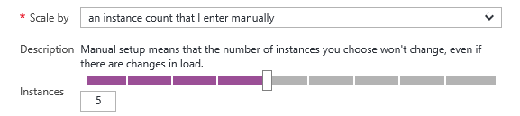
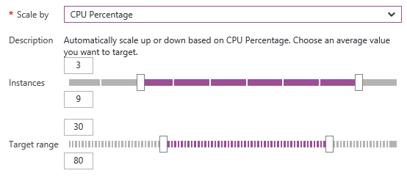
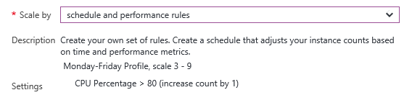
Manual Scaling vs. Auto-Scaling
Manual – Scale via portal or scripts
Auto – CPU Percentage
Auto – Schedule & Performance Rules

Slide 8

Web App
Notes:
Demonstrate scaling out in this and the next two slides by showing the VM count increasing as traffic increases.

Slide 9
Web App

Slide 10
Web App

Slide 11
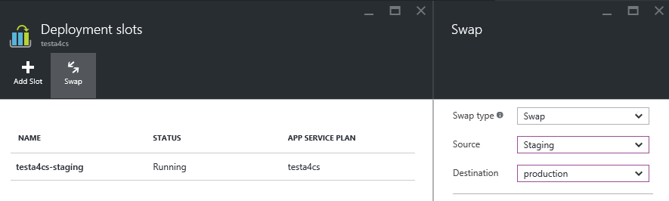
Deployment Slots
Use a Deploy-Confirm-Promote workflow
Promote via “swap” through Azure portal
http://sitename-slotname.azurewebsites.net

Slide 12
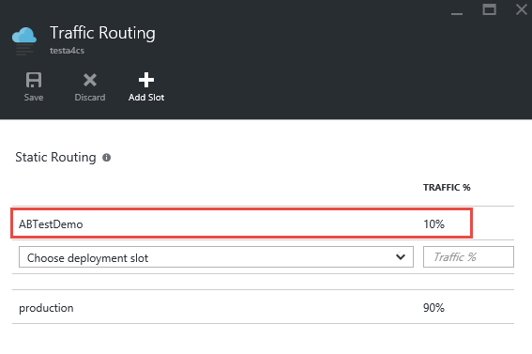
A/B Testing
Test changes by routing requests to different deployment slots
Use Traffic Routing to direct % of traffic to alternate slots

Slide 13






Continuous Integration
Web apps can be deployed manually via FTP or WebDeploy
Automate deployment using 3rd party source-control providers
Can also use a local Git repository from Azure Portal
Git
Visual Studio Team Services
CodePlex
GitHub
BitBucket
DropBox

Slide 14


Continuous Integration + Deployment Slots
Production
5
Developer commits code
Automated process builds/compiles and deploys to staging slot
Automated and other tests validate content in staging slot
Staging content promoted to production
Users see updated site
1
4
2
3
Source Control
Staging
Test

Slide 15
App Service Plans
Billing and provisioning for App Service resources
 | Free | Shared | Basic | Standard | Premium
# of Apps | 10 | 100 | Unlimited | Unlimited | Unlimited
Shared Disk Space | 1 GB | 1 GB | 10 GB | 50 GB | 500 GB
Maximum Instances | 1 | 1 | 3 | 10 | 50
Autoscale | No | No | No | Yes | Yes
Staging Environments |  |  |  | 5 | 20
Custom Domains | No | Yes | Yes | Yes | Yes
SLA |  |  | 99.95%

Slide 16
DEMO
Azure Web Apps HOL.html

